Slide 1
College Finance Department Digital Twin
Integrative Software Engineering class – 10143
Team Shahar Michaeli Project Documentation

Slide 2
Requirements Document

Slide 3
Introduction
As in every public institute there is a need for a finance department to manage and process the finances for its operation.
The system is one that simulates the digital twin of a college financial department.
Our system takes into account a college in which we have students attending predetermined course, a worker that teaches predetermined classes and an office that oversees and manages the payment surrounding them.
Purpose
Manage salary payments to lecturers.
Track of payments, make a payment.
Manage the finances and assist the administrative staff in organizing the salaries of workers and payments form students.
Scope
The scope of this system is a web-based application to be used as an interface for managing financial information such as worker salary, student balance and generation of reports. Payment processing, course managing, messaging are not a part of the system.

Slide 4
Actors
Primary Actors
Student
Worker
Office Worker
Support Actors
Bank
Credit Card Center

Slide 5
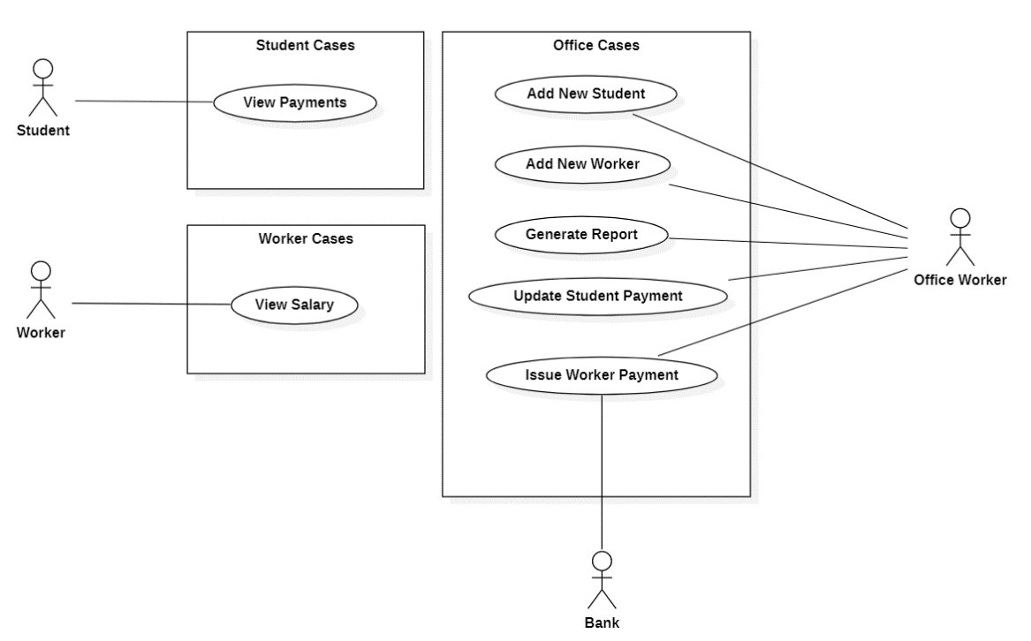
Functional Requirements
Use Case Diagram

Slide 6
Functional Requirements
Student payment statement view
Student checks his balance.
Worker salary statement view
Worker checks his payments.
Office issues payment to worker
Office sends payment to worker.
Office updates student’s payment
Office updates and requests payement from student.
Generate report
Generate financial report for the college.
Add new student
Office adds new student into system.
Add new worker
Office adds new worker into system.

Slide 7
Non-Functional Requirements
Type | Description
No need for special instruction for using the system | Usability
Real time availability of information stored in the data base | Reliability
90% of queries and requests receive a response within 5 seconds | Performance
Full support of chosen operation for students, workers and office workers | Supportability

Slide 8
Tech Stack
Front End
HTML, CSS, JavaScript
Back End
Java
Spring Boot
Database
MySQL
Clever Cloud
MySQL Workbench
Testing
Postman
Junit
Miscellaneous
Microsoft Office
Trello
StarUML

Slide 9
Summary

Slide 10
Satisfaction
Every team member took his role with great responsibility and did their part in time and in good quality. This caused everyone to work in synergy and helped us be efficient and finish our tasks on time.
Open communication and availability of team members. Even though we could not meet up in person we talked via group messages and online meetings. Everyone was available and actively participated in the development process.

Slide 11
Lessons
It was hard to coordinate the work of multiple team members. Using GIT version control and working on the same files proved to be a challenge even in the last sprint.
It would improve our teamwork even further if we had set rules and directives for ourselves. Setting expectations upfront will make a difference.

Slide 12
Fun
Building a back end from scratch. It is amazing to witness how things click together and build them ourselves. It is a new experience for all of us.
This course felt like actual practical experience – a good change from theoretical algorithm classes or design principle general talk. We got the code and developed a small system which works, and its development process is in touch with how the “real” world development process is.

Slide 13
Retrospect
Delegate responsibilities early on and in a more efficient way. For example, appoint a team member to manage and direct how the version control works. It took quite some time before we polished our teamwork.

Slide 14
Remote
Working remotely allowed for setting up meetings easier. Even with remote work we had some trouble setting a time that met everyone’s schedule so we cannot imagine what it would be like if we had to meet in person outside of the college.
It prompted us to use different tools and technologies to coordinate ourselves. Kanban, Git, WhatsApp and Zoom to name a few.
Considering how most of the world starts working remotely, especially in the programming and development sector it is a blesses opportunity.

Slide 15
Thank you

